Slide 1
CPS 4982 – Big Data Analytics
Lecture 6 Docker Basics
Dr. Changjiang Zhang

Slide 2
Contents
What is Docker?
How Docker works?
Basic Terms
Where to get started?

Slide 3
Docker
A tool designed to make it easier to create, deploy, and run applications using Containers.
Containers allow a developer to package an application with all the parts it needs, such as libraries and other dependencies, and ship it all out as one package.

Slide 4
Docker
Is a Fancy way to run a process, not a virtual machine.
Containers run in a Shared Environment
Reduced Scale time
Reduced resource consumption
Without overhead of the VM(Virtual Machine)

Slide 5

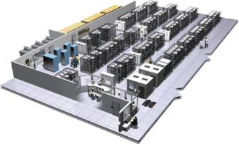
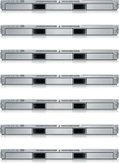
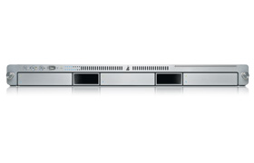
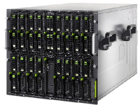

The Challenge
User DB
Static website
postgresql + pgv8 + v8
Queue
Analytics DB
nginx 1.5 + modsecurity + openssl + bootstrap 2
Do services and apps interact appropriately?
Multiplicity of Stacks
Redis + redis-sentinel
hadoop + hive + thrift + OpenJDK
Background workers
Web frontend
Python 3.0 + celery + pyredis + libcurl + ffmpeg + libopencv + nodejs + phantomjs
Ruby + Rails + sass + Unicorn
API endpoint
Python 2.7 + Flask + pyredis + celery + psycopg + postgresql-client
Production Cluster
Development VM
Public Cloud
Multiplicity of hardware environments
QA server
Can I migrate smoothly and quickly?
Disaster recovery
Customer Data Center
Contributor’s laptop
Production Servers

Slide 6
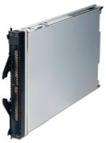
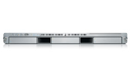
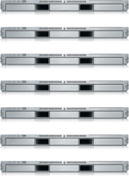


The Matrix From Hell
? | ? | ? | ? | ? | ? | ?
? | ? | ? | ? | ? | ? | ?
? | ? | ? | ? | ? | ? | ?
? | ? | ? | ? | ? | ? | ?
? | ? | ? | ? | ? | ? | ?
? | ? | ? | ? | ? | ? | ?
Static website
Web frontend
Background workers
User DB
Analytics DB
Queue
 | Development VM | QA Server | Single Prod Server | Onsite Cluster | Public Cloud | Contributor’s laptop | Customer Servers

Slide 7
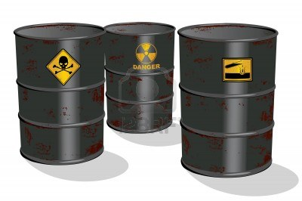
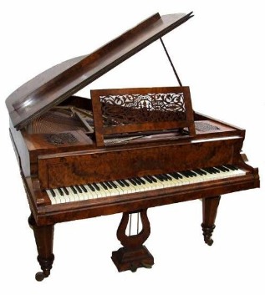

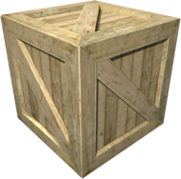
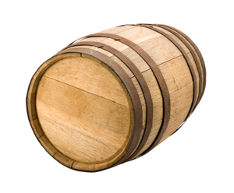
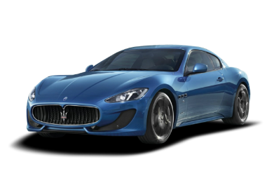
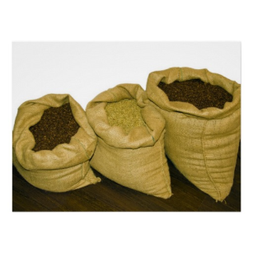



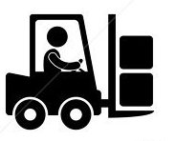
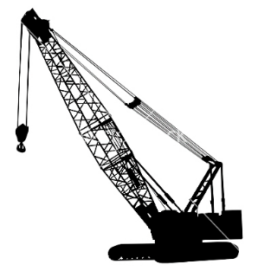
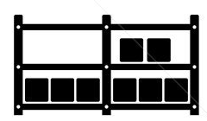

Cargo Transport Pre-1960
Do I worry about how goods interact (e.g. coffee beans next to spices)
Multiplicity of Goods
Multipilicity of methods for transporting/storing
Can I transport quickly and smoothly
(e.g. from boat to train to truck)

Slide 8
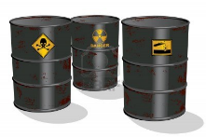

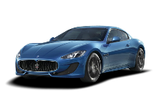


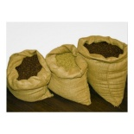


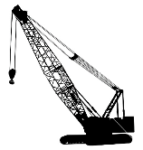



Also a matrix from hell
 | ? | ? | ? | ? | ? | ? | ?
 | ? | ? | ? | ? | ? | ? | ?
 | ? | ? | ? | ? | ? | ? | ?
 | ? | ? | ? | ? | ? | ? | ?
 | ? | ? | ? | ? | ? | ? | ?
 | ? | ? | ? | ? | ? | ? | ?

Slide 9

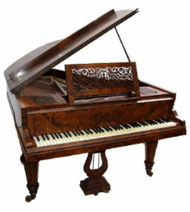

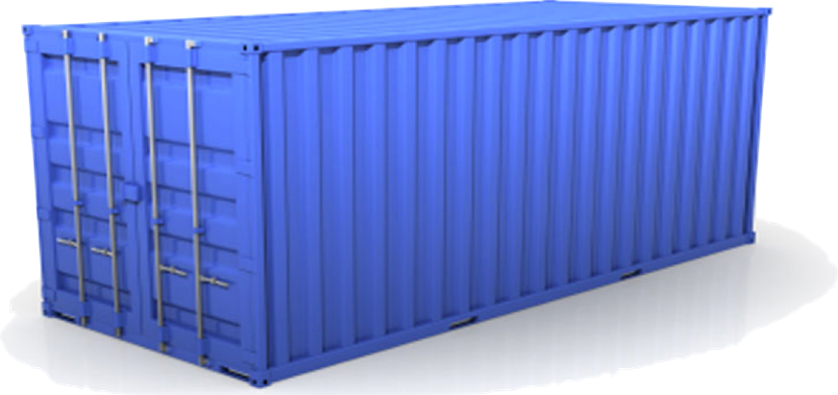
Solution: Intermodal Shipping Container
Do I worry about how goods interact (e.g. coffee beans next to spices)
Multiplicity of Goods
A standard container that is loaded with virtually any goods, and stays sealed until it reaches final delivery.
…in between, can be loaded and unloaded, stacked, transported efficiently over long distances, and transferred from one mode of transport to another
Can I transport quickly and smoothly
(e.g. from boat to train to truck)
Multiplicity of methods for transporting/storing

Slide 10
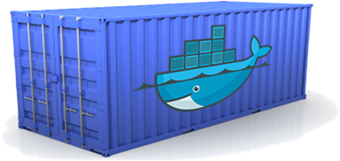
Docker is a shipping container system for code
Static website
User DB
Web frontend
Queue
Analytics DB
Do services and apps interact appropriately?
Multiplicity of Stacks
An engine that enables any payload to be encapsulated as a lightweight, portable, self-sufficient container…
…that can be manipulated using standard operations and run consistently on virtually any hardware platform
Multiplicity of hardware environments
Can I migrate smoothly and quickly
Development VM
QA server
Customer Data Center
Public Cloud
Production Cluster
Contributor’s laptop

Slide 11

Docker eliminates the matrix from Hell
Static website
Web frontend
Background workers
User DB
Analytics DB
Queue
 | Development VM | QA Server | Single Prod Server | Onsite Cluster | Public Cloud | Contributor’s laptop | Customer Servers

Slide 12
Docker – Basic Terms
Docker Engine
The Docker project as a whole, which is a platform for developers and sysadmins to develop, ship, and run applications
The Docker daemon process running on the host, which manages images and containers
Docker Engine = Docker Daemon + Docker CLI

Slide 13
Docker – Basic Terms
Container
A container is a runtime instance of a Docker image
A Docker container consists of
  A Docker image
  Execution environment
  A standard set of instructions

Slide 14
Docker – Basic Terms
Node
A node is an instance of the Docker engine participating in the swarm

Slide 15
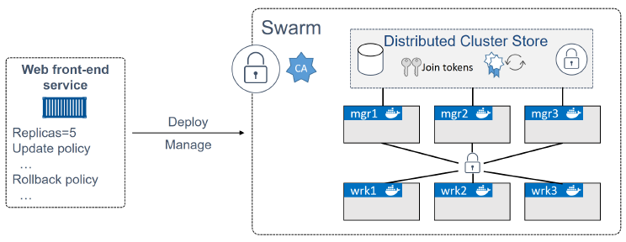
Docker – Basic Terms
Swarm
A swarm is a cluster of Docker engines, or nodes, where you deploy services.

Slide 16
Docker – Basic Terms
Docker For Mac
Docker development environment designed specifically for the Mac OS.
Native Mac application; uses the macOS Hypervisor framework, networking, and filesystem.
Best solution if you want to build, debug, test, package, and ship Dockerized applications on a Mac.

Slide 17
Docker – Basic Terms
Docker For Windows
Docker development environment designed specifically for Windows 10/11 systems that support Microsoft Hyper-V.
It works with Windows Server 2016, and gives you the ability to set up and run Windows containers as well as the standard Linux containers, with an option to switch between the two.

Slide 18
Docker – Basic Terms
Docker Hub
Docker Hub is a cloud-hosted service from Docker that provides registry capabilities for public and private content
The most common registry is Docker Hub (https://hub.docker.com). Most images are stored in Docker Hub.

Slide 19
Docker – Basic Terms
Docker Registry
A Registry is a hosted service containing repositories of Docker images
The default registry can be accessed using a browser at Docker Hub or using the Docker search command

Slide 20
Docker – Basic Terms
Docker Image
A union of layered filesystems stacked on top of each other.
An image does not have state, and it never changes
It’s useful to think of a Docker image as an object that contains an OS filesystem, an application, and all application dependencies.

Slide 21
Docker – Basic Terms
Docker File
A text document that contains all the commands you would normally execute manually to build a Docker image
Docker can build images automatically by reading the instructions from a Dockerfile

Slide 22
Virtualization
In its conceived form, it was considered a method of logically dividing mainframes to allow multiple applications to run simultaneously.
Evolved gradually with the support of companies and open-source communities to allow multiple OS to run simultaneously.

Slide 23
Hypervisor
Handles creating the virtual environment on which the Guest OS operate.
Makes sure that resources are allocated to the guests as necessary.
Sits in between the physical machine and virtual machines and provides virtualization services to the virtual machines.
It intercepts the guest operating system operations on the virtual machines and emulates the operation on the host machine's operating system

Slide 24
Types of Virtualization
The virtualization method can be categorized based on how it mimics hardware for a guest operating system and emulates the guest operating environment. Primarily, there are three types of virtualization:
Emulation
Paravirtualization
Container-based virtualization

Slide 25
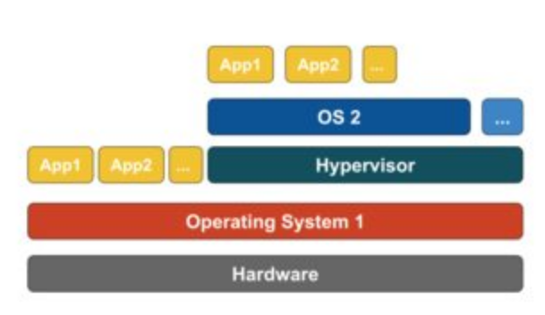
Types of Virtualization - Emulation
Known as Full Virtualization, Type-2 Hypervisor
Is installed on top of the host operating system
Responsible for translating guest OS kernel code into software instructions
The translation is done entirely in software and requires no hardware involvement
Examples: VMware Player, VirtualBox, QEMU, Parallels, etc.

Slide 26
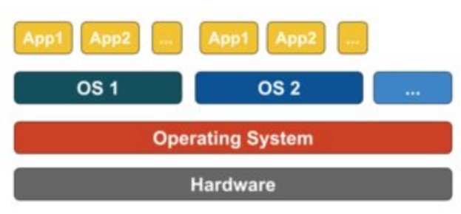
Types of Virtualization - Paravirtualization
Runs directly on the hardware, or “bare-metal”, Type-1 Hypervisor.
Helps the operating system, the virtualized hardware, and the real hardware collaborate to achieve optimal performance
Example: Xen, KVM

Slide 27
Types of Virtualization – Container Based V.
Known as OS-Level Virtualization
Enables multiple isolated executions with a Single OS Kernel
Offers the Best Performance
Can be viewed as a traced group of processes.
Example: Docker, Kubernetes, etc.

Slide 28
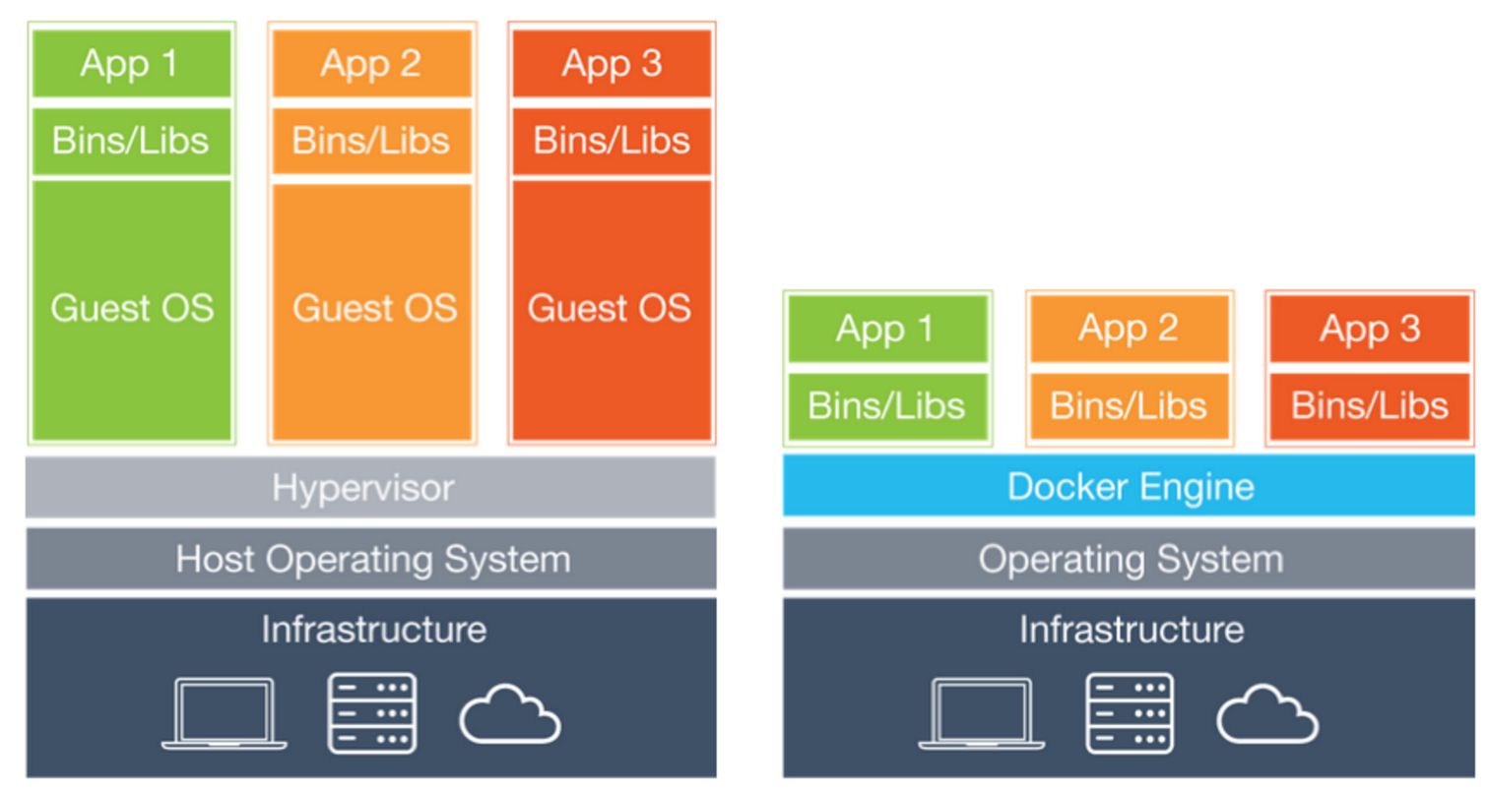
Docker – Containers vs. VMs
Virtual Machine
Docker

Slide 29
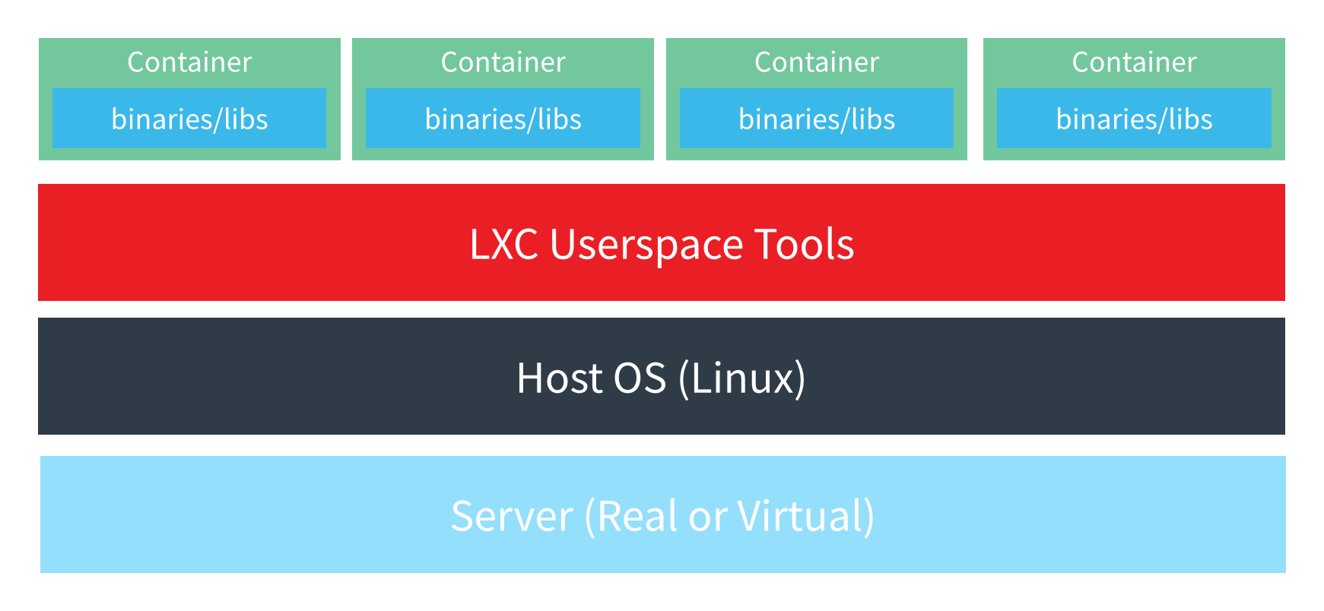
Docker – Containers
You cannot run a windows container on a Linux host because there is no Linux Kernel support for windows

Slide 30
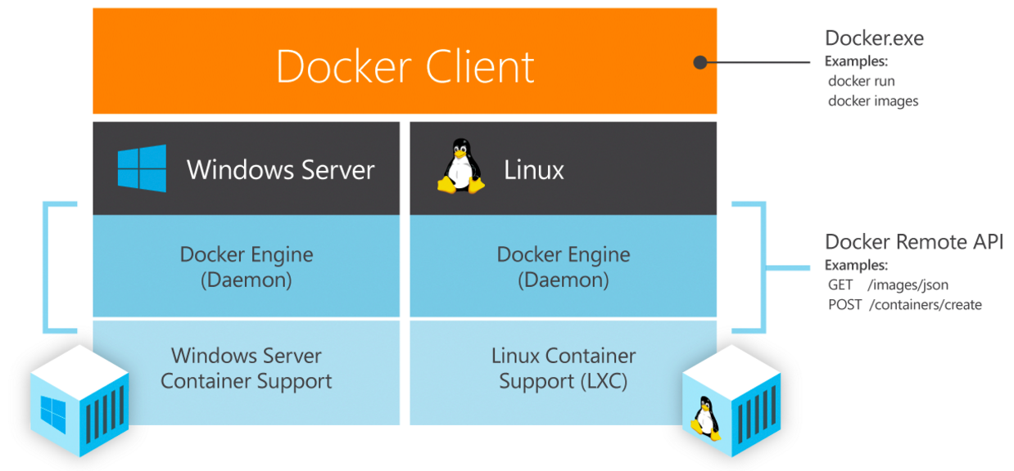
Docker – Native Support

Slide 31
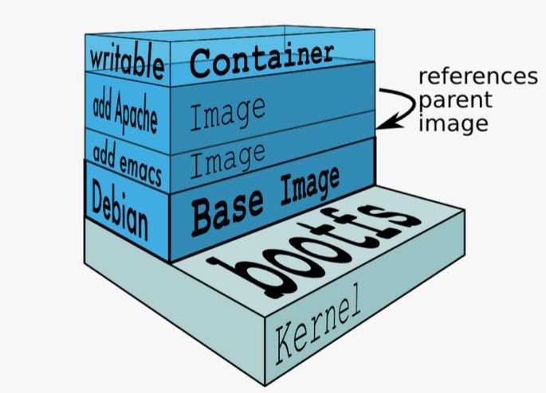
Docker – Platform workflow

Slide 32
Docker – Platform workflow
Find an Image on Docker Hub
Pull the Image from Docker Hub (download images)
Run the Image on the Docker Host as a container
Stop the container
Remove a container
Remove an Image

Slide 33
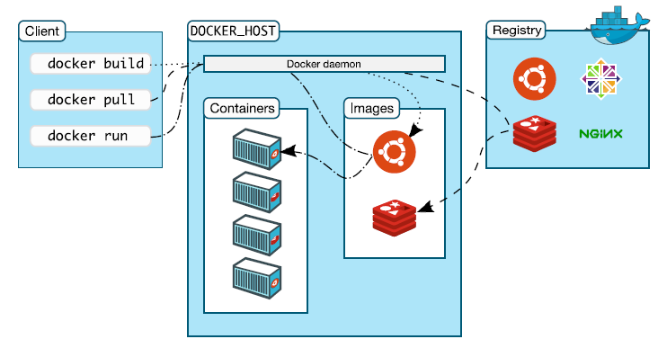
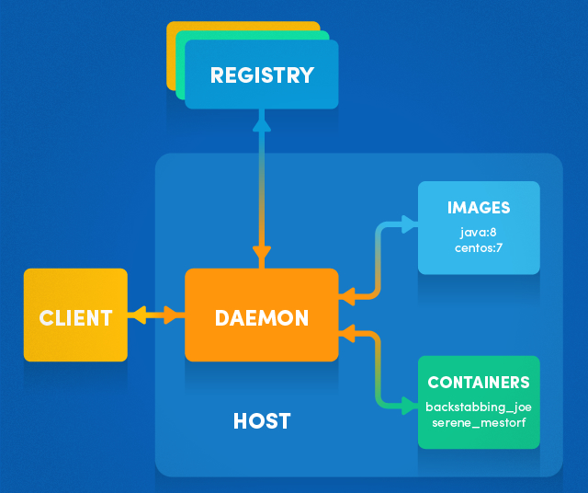
Docker – How it works?

Slide 34
Docker File
# Sample Dockerfile
# Indicates that the windowsservercore image will be used as the base image.
FROM microsoft/windowsservercore
# Metadata indicating an image maintainer.
MAINTAINER jshelton@contoso.com
# Uses dism.exe to install the IIS role.
RUN dism.exe /online /enable-feature /all /featurename:iis-webserver /NoRestart
# Creates an HTML file and adds content to this file.
RUN echo "Hello World - Dockerfile" > c:\inetpub\wwwroot\index.html
# Sets a command or process that will run each time a container is run from the new image.
CMD [ "cmd" ]

Slide 35
Docker – Where to get started?
https://training.docker.com - Free self-paced courses
https://docs.docker.com/engine/getstarted/ - Docker Reference
https://hackr.io/tutorials/learn-docker - Free Video Tutorials
https://www.pluralsight.com - Plural sight
https://www.mva.microsoft.com – Microsoft Virtual Academy

Slide 36
Exercise
Do the Docker tutorial exercise

